Slide 1

Group C3: Project 1
By: Corey Anderson, Erin zheng, will Jung & Chuck Youngman

Slide 2
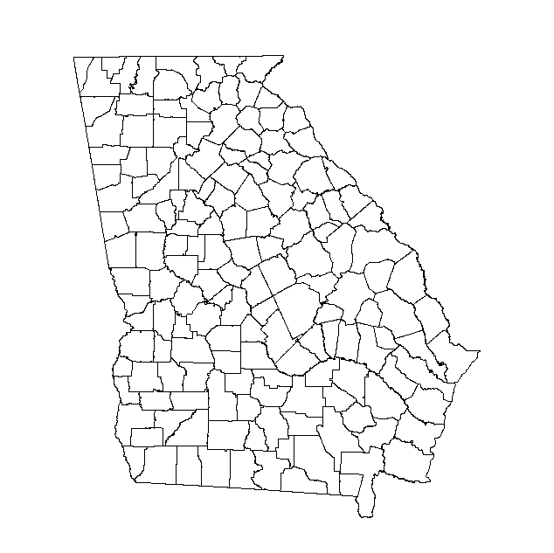

Project Summary
Distribution of (auto*) insurance companies, by county, in Georgia, USA relative to...
Population size (2019).
Number of car accidents (from 01-Jan-2017 through 23-Aug-2019).

Slide 3
Background
Many companies, such as insurance brokerages, have franchises or local offices.
Making decisions about new locations requires information about where other offices are located.
Same company.
Territorial Issues
Different companies.
Competitors
Also requires information about important extrinsic factors.
Auto Insurance:
Demographics
Where and how many accidents occur.

Slide 4
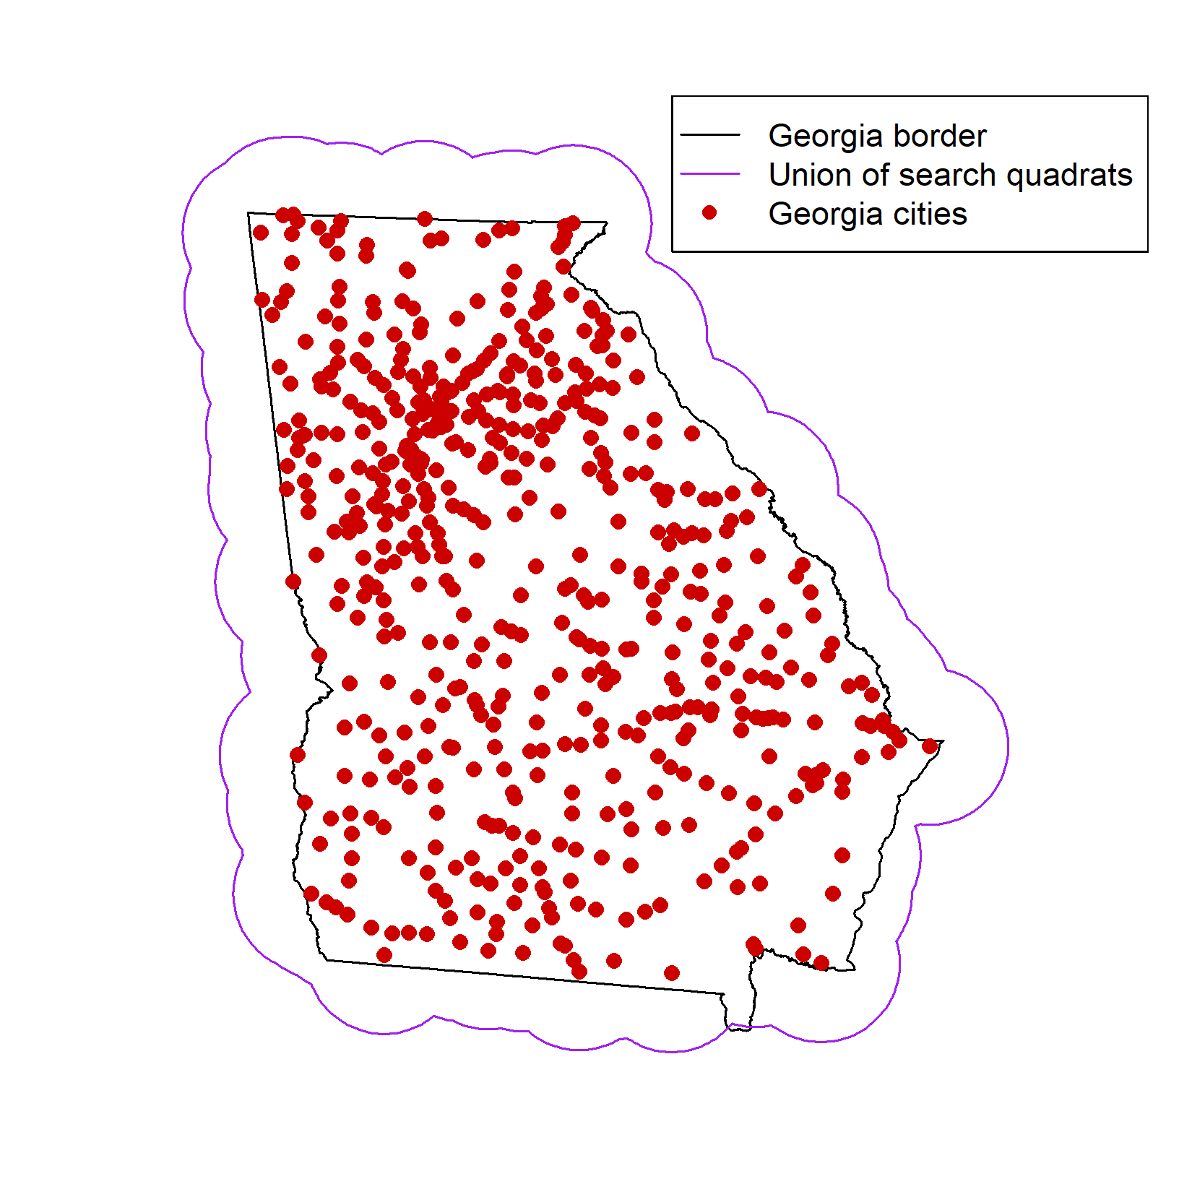
Data sources
US Census Bureau 2019
(GA counties)
(GA cities/towns/city-counties)
(.csv)
1
n = 538
Google Maps API
Geocode (cities lat/lon)
Places (type: insurance_agency)
2
3
4
Reverse geocode
(to get county name)
Kaggle
US Accidents (Moosavi et al. 2019)
4.2 million records
(.csv)
ESRI, ARC
polygon shapefiles (.shp):
GA counties (ESRI)
GA state boundary (ARC)
Method 1: location = cities (lat/lon)
radius = 50 km
next_page_token

Slide 5
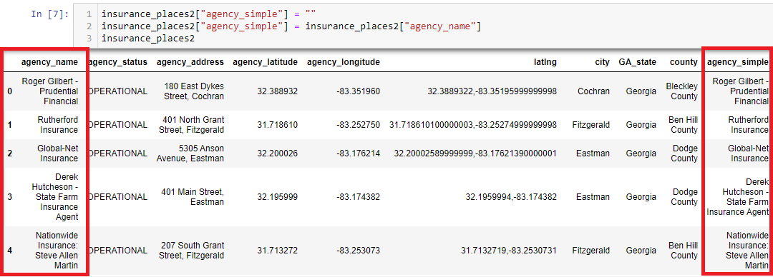
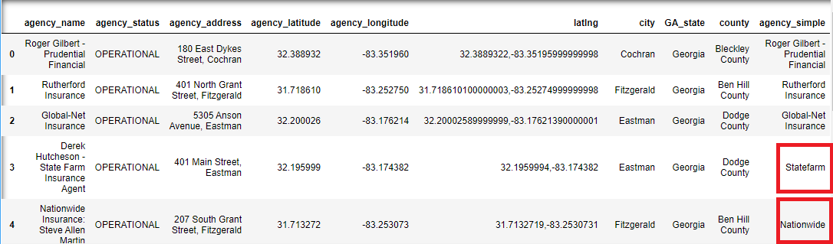
Insurance Data Cleanup & Exploration
Places API Search – 50k Radius
30k+ outputs of insurance agencies
Multiple duplicate agencies
Solved by dropping duplicates through pandas (had to dropout the target coordinates)
Non-Auto Agencies
Used a keyword search utilizing "str.contains" funtion for the non-auto agencies (BB&T, Suntrust, etc) and dropped them from our dataframe.
Insurance agencies had different names for the same agency. (i.e Derek Hutcheson – State Farm Insurance Agent)
Solved this issue by copying our lists of agencies under the "agency_name" column into another column called "agency_simple." This was to keep the original name of the insurance agency.
With the our new "agency_simple" column we were then able to use the str.contains function to search all the agencies under the same company.
We then replaced the name of the agency under the "agency_simple" column to make all the names similar under one company. This was to make sorting and merging data simpler.
Search did not separate by county
Had to clean data to identify specific counties by reverse geocoding
Able to use reverse geocoding by using latitude/longitude to separate each location by state/county
Outputs out of state borders
Continued utilizing reverse geocoding to identify each locations state
Dropped all locations that were not in GA

Slide 6
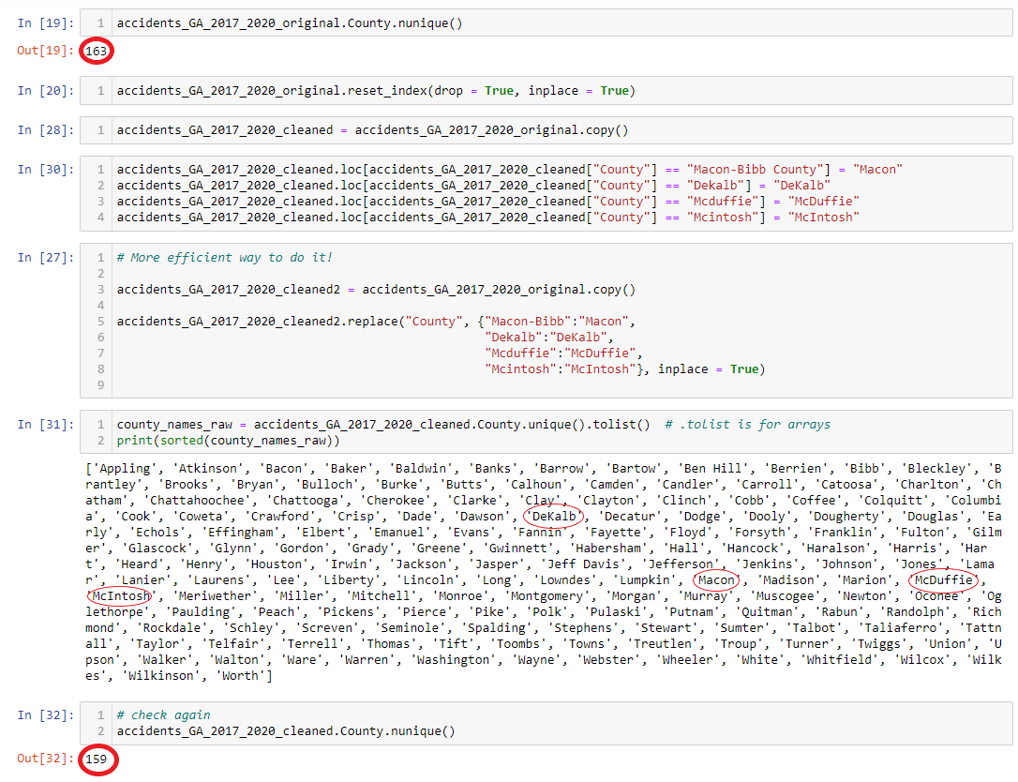
Accident DATA CLEANUP & EXPLORATION
Multiple County Iterations
Macon vs Macon-Bibb
County Spelling
County names were showing different case distinctions
DeKalb vs Dekalb
McDuffie vs Mcduffie
McIntosh vs Mcintosh
Resulting in county count being incorrect (163 vs 159)

Slide 7

After DATA CLEANUP
Cleaning the insurance agency data:
We started with 30,545 rows after using the Places API search.
After dropping duplicates, we ended up with 1,831 rows of data.
After dropping all insurance agencies out of state, we ended up with 1,604 rows.
After dropping non-auto insurance agencies, we finally ended up with 1,510 rows.
Cleaning the accident data:
We started with 4.2 million rows of data using the Kaggle US Accidents API.
After narrowing down to data only in Georgia, we ended up with 93,874 rows of data.

Slide 8
Statistical methods
Hot-spot Analysis.
Getis-Ord G statistics.
Measures the proportional sum of counts around a location (relative to the total sum).
Identify counties where the sum of counts around that spot makes up a high or low proportion of the total sum.
Used G* (G-star): the focal county is included in the sum.
All counties touching a county included.

Slide 9
RESULTS

Slide 10
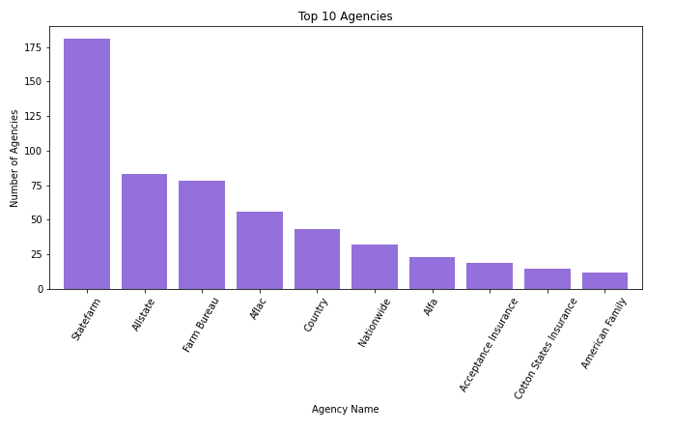
Top 10 companies
Shows Top 10 Brick-and-Mortar Agencies in Georgia
Nearly 1000 total unique agencies with only the top 10 agencies having more than 10 locations

Slide 11
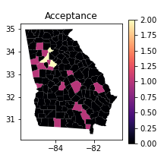
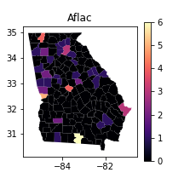
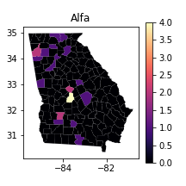
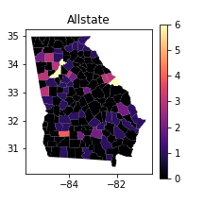
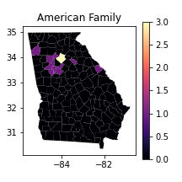
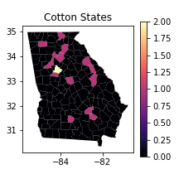
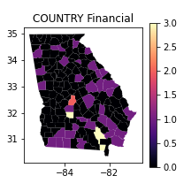
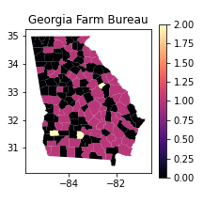
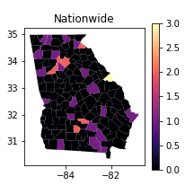
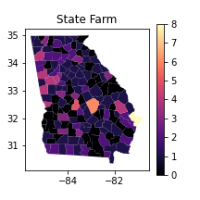
Counts of the top ten most frequent insurance companies per county in GA, USA
(in alphabetical order)

Slide 12
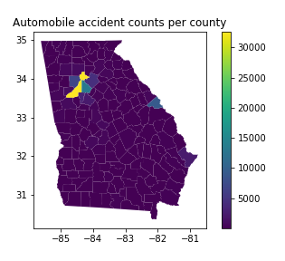
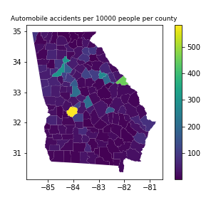
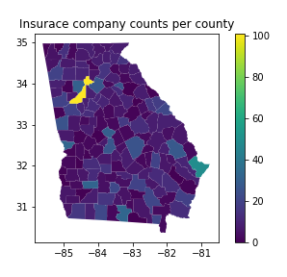
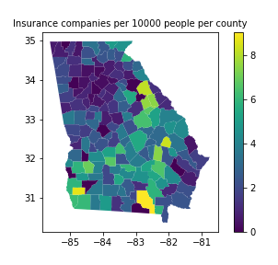
Automobile accident counts and rates (per 10000 people) in Georgia, USA counties.
Automobile insurance company counts and rates of occurrence (per 10000 people) in the counties of Georgia, USA.

Slide 13
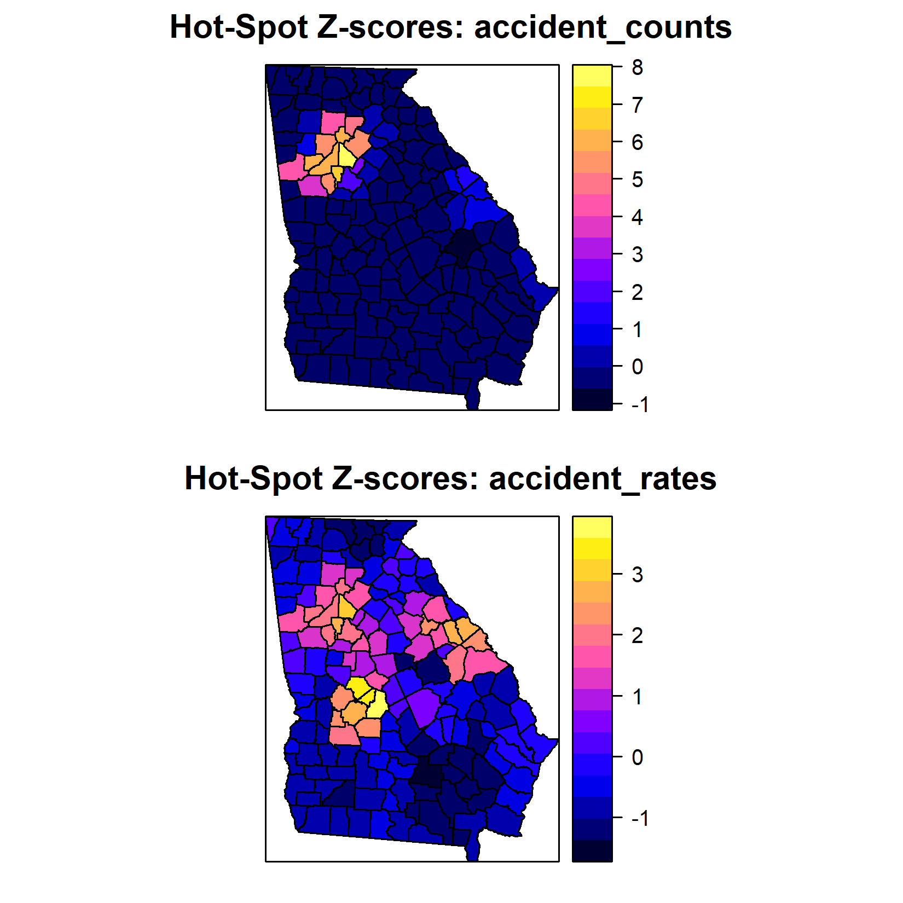
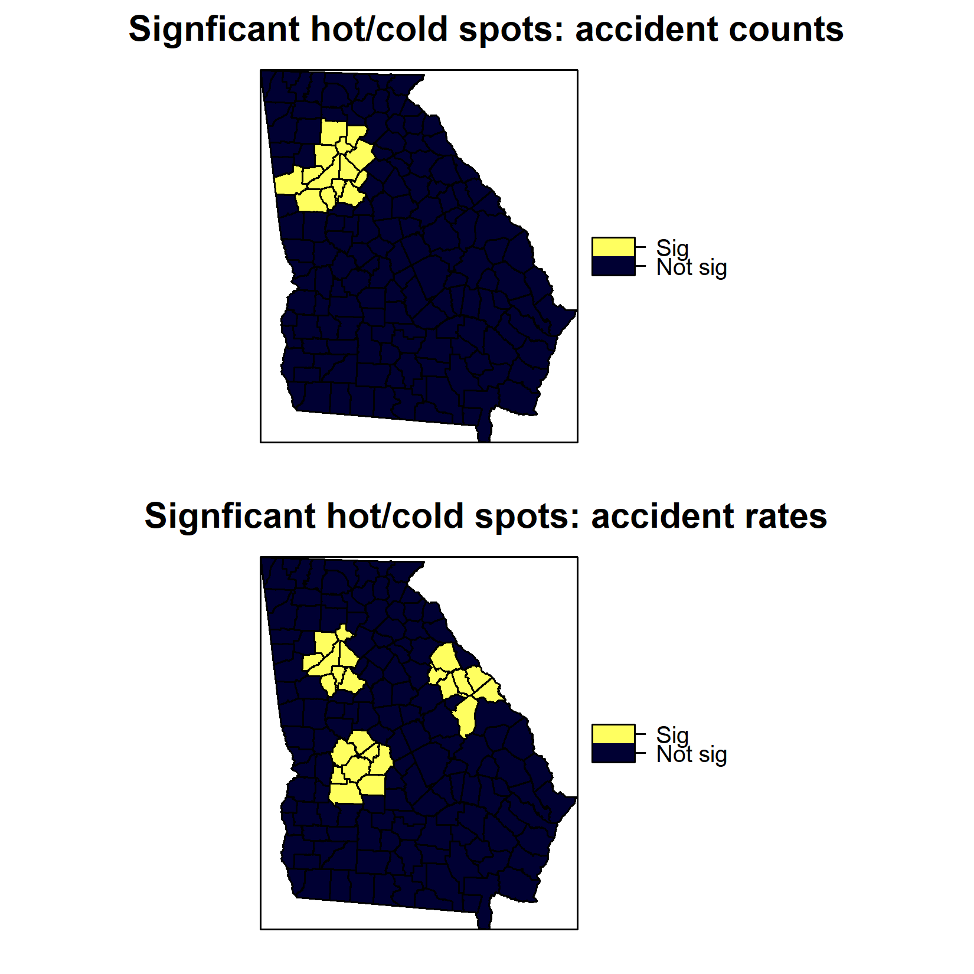
Hot-Spot Analysis: Automobile Accident Counts (top) and Rates per 10000 people (bottom)

Slide 14
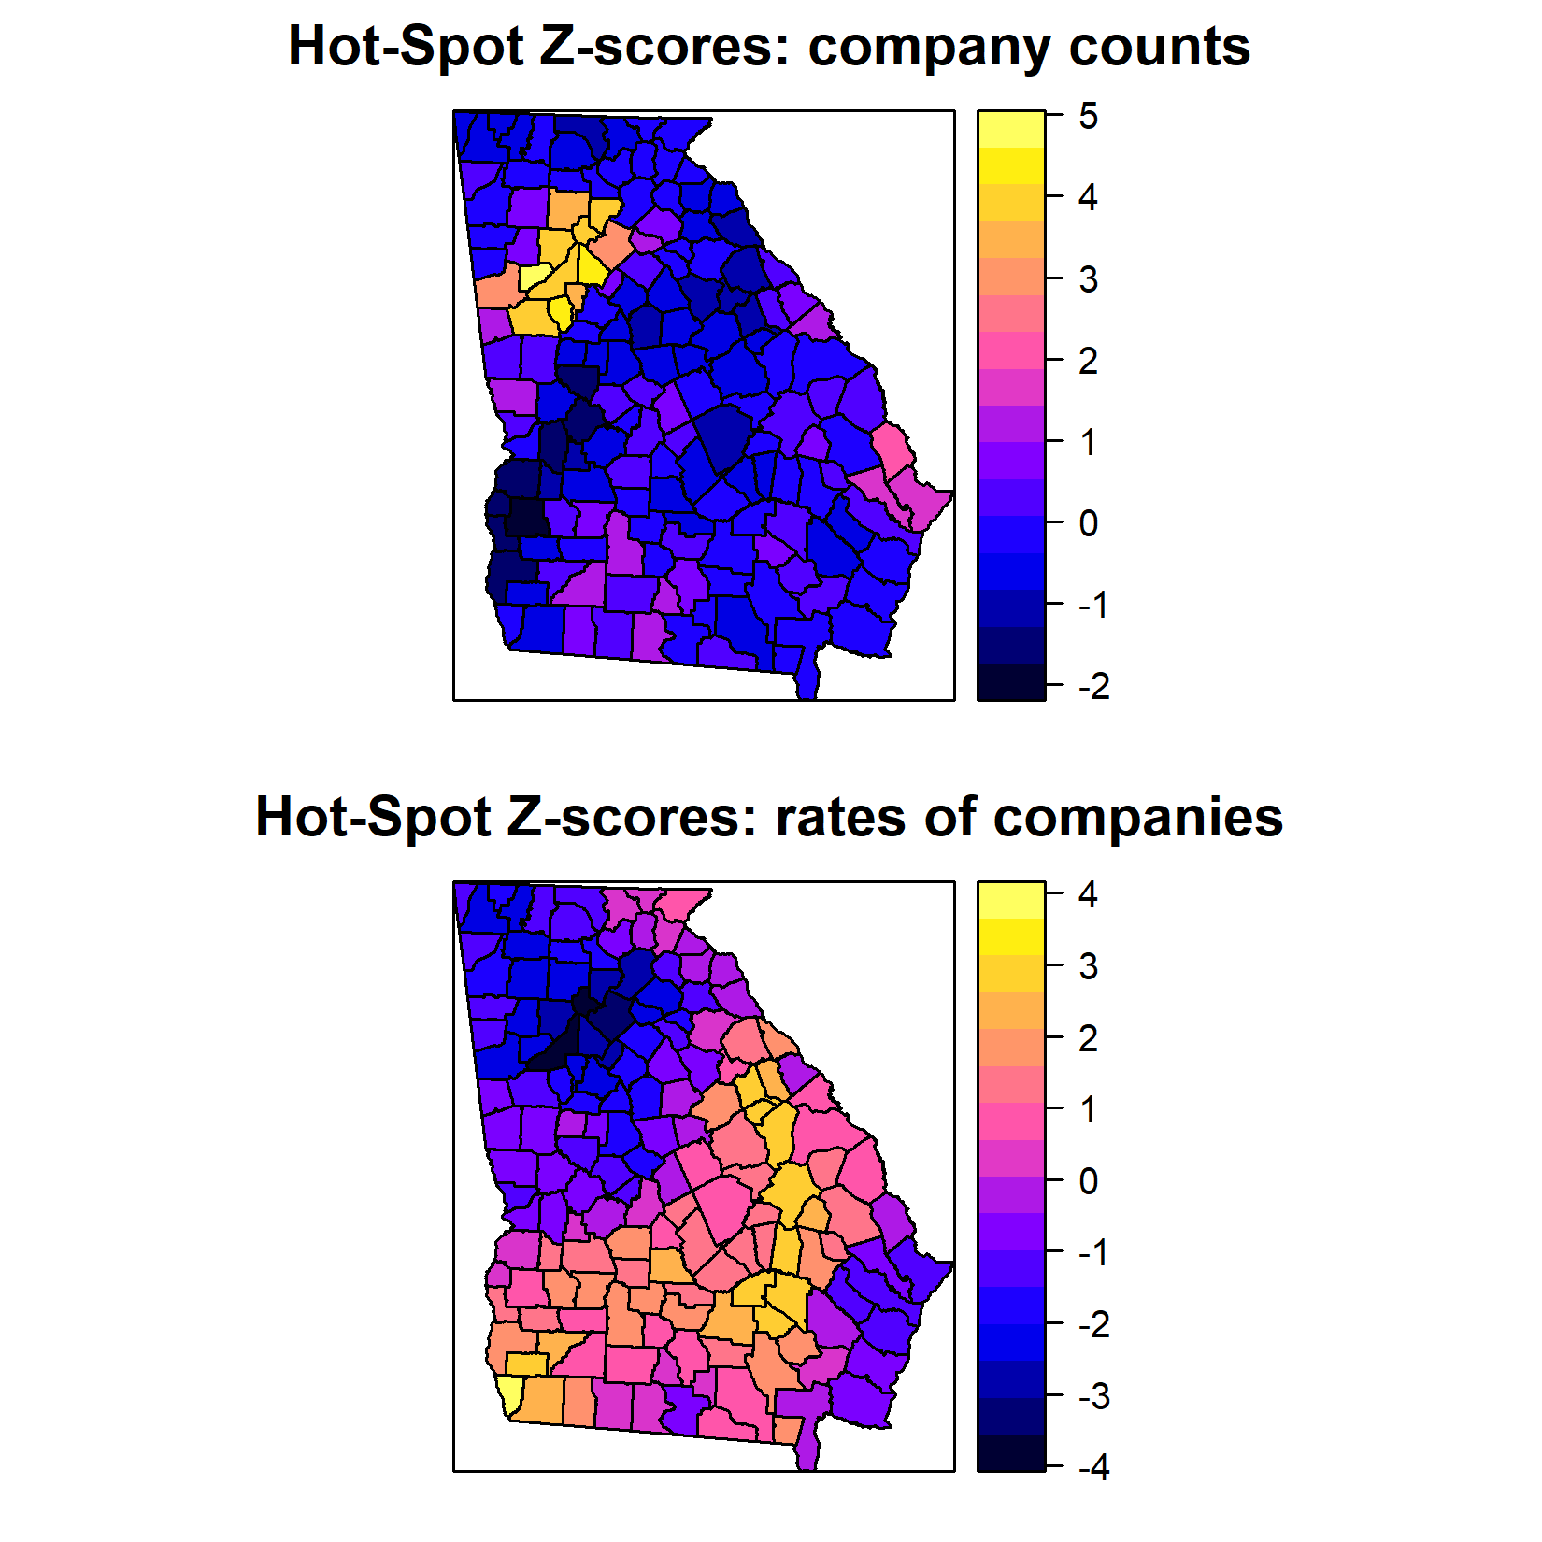
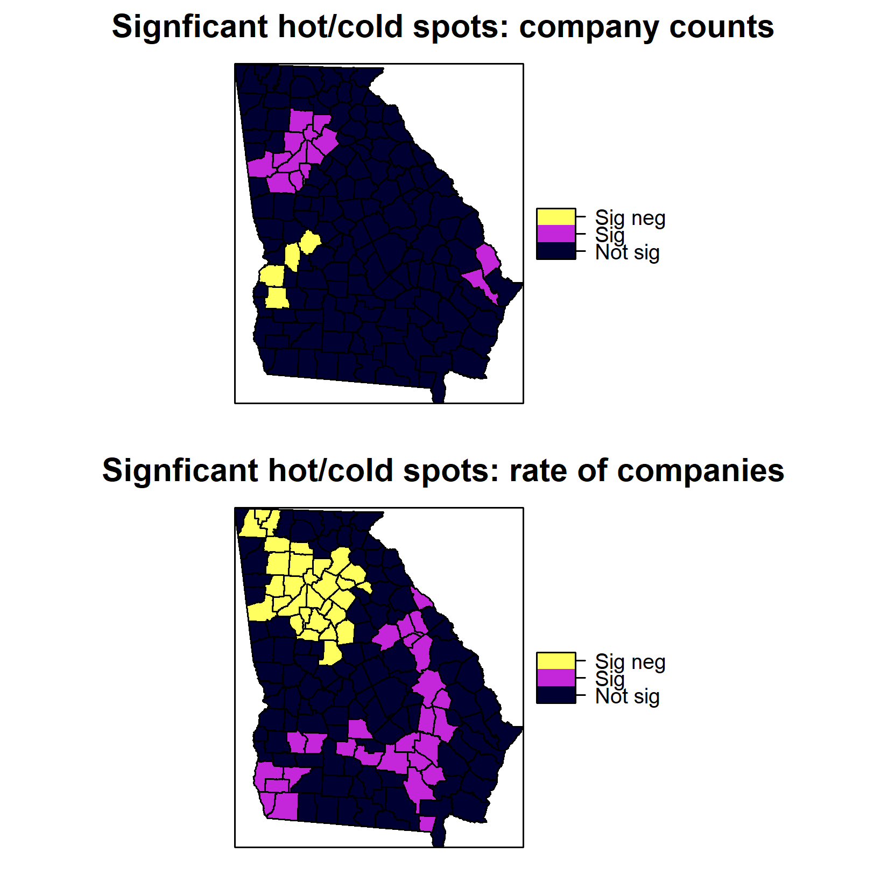
Hot-Spot Analysis: Insurance Company Counts (top) and Rates Per 10000 people (bottom).

Slide 15
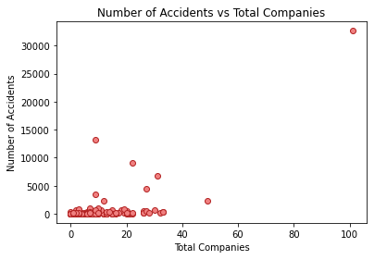
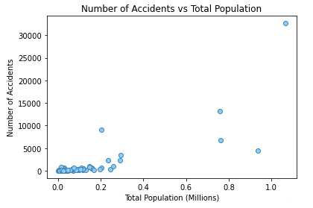
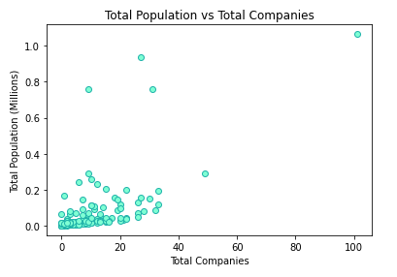
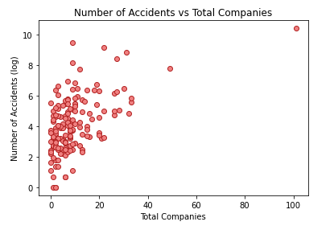
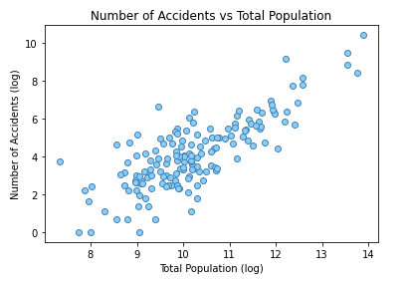
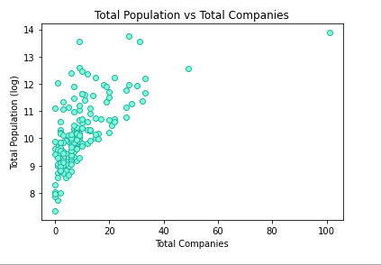
Scatterplots Comparing All of Our Data Sources

Slide 16
GLM RESULTS/DIscussion:
Poisson Regression not ideal for these data.
Poisson distribution assumes that the mean and variance are equal.
Our data: 9.50 / 123.57 = 0.08 # Overdispersion:: variance much higher than mean.
The responses are heteroskedastic.
Variance in the response increases with population count.
Outliers a problem, even for a model that accounts for overdispersion.
Responses are also spatially structured.
Nearby counties have similar counts and rates of agencies and accidents.
Counties don't represent independent sample units.
Regression may not work well for these data....maybe local regression.
Need more predictors...not just accident rate.

Slide 17
Discussion
Lots of variation in how particular companies are distributed in the state.
Ten companies dominate.
Lots of State Farm locations.
Some widespread (e.g., Farm Bureau) in rural areas.
Overall rates higher in rural areas.
Rural areas focus more on customer service and older clients.
Surprisingly low rates in urban areas
Accident counts and rates significantly high in metropolitan areas (esp. areas with freeways).
Prevalence not highest in metro Atlanta area.
Associating insurance company locations with extrinsic data is complicated.
Lots of potential factors.
Need spatially explicit methods.

Slide 18
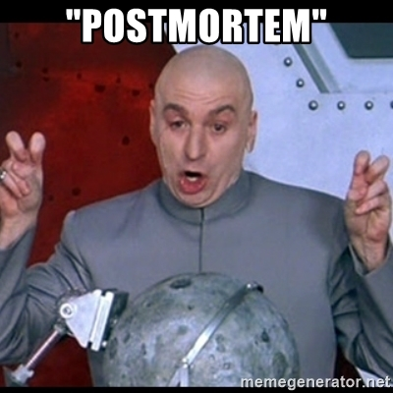
POST MORTEM...
Finding APIs
Started with Yelp to call insurance agencies.
Sources had to be rated to appear.
Issues with Mapquest.
Accidents reports reflect they are reported by somebody on their smart phone.
Identifying agencies.
Duplicates, Boutiques, or a title pawn shop that sells it all!
Online brokers,
Keywords to use.
Google is good but not perfect.
Not all places listed.
Max of 60 results.
Need multiple sources to get all of the agencies.
The data are complicated.
The assumptions of most standard regression models are violated.
Need better search efficiency: searching from all city centroids may be inefficient with a large search radius...and so is having to reverse geocode...

Slide 19
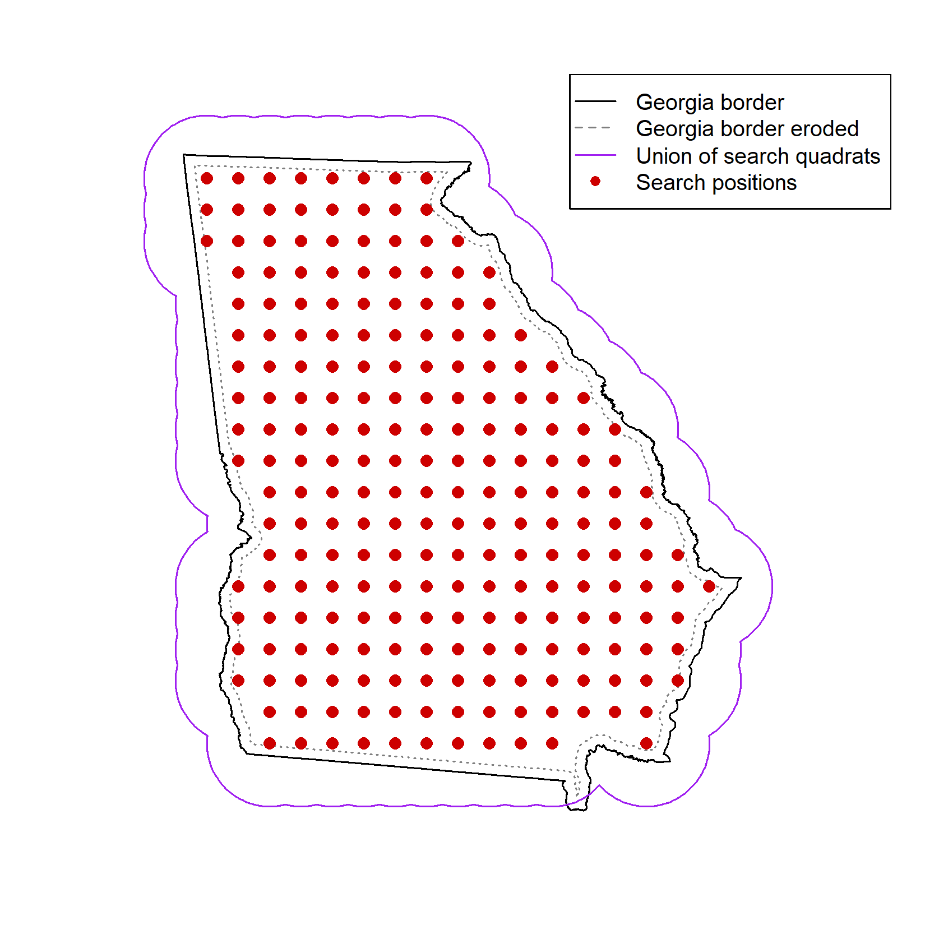
Systematic grid of points
(25 km spacing) in R (sp, spatstat)
Use optimized grid instead of cities in places search.
US Census Burrow 2019
(GA counties)
(GA cities/towns/city-counties)
(.csv)
1
n = 237
Google Maps API
Places (type: insurance_agency)
2
4764
X
Spatial join instead!
(no reverse geocoding)
3
Reverse geocode
(to get county name)
Kaggle
US Accidents (Moosavi et al. 2019)
4.2 million records
(.csv)
1266 rows
(no out of state, prior to final cleaning)
ESRI, ARC
polygon shapefiles (.shp):
GA counties (ESRI)
GA state boundary (ARC)
Method 2: location = grid position (lat/lon)
radius = 50 km
next_page_token
Notes:
Need to finish this slide once we have finished pipeline..

Slide 20


Questions And Answers

